Slide 1
DATABASE MANAGEMENT SYSTEM · FINAL PRESENTATION (III)
LABORATORY EQUIPMENT
BOOKING & MAINTENANCE
MANAGEMENT SYSTEM
Working User Interface connected to MySQL — Insert - Delete - View
SHAURYA DHINGRA - 25WU0102254
AIML WHALES
Notes:
Good afternoon. I am Shaurya Dhingra, Project 29 - Laboratory Equipment Booking and Maintenance System. In Presentation I I showed the problem, in Presentation II the database design. Today I will demonstrate the working user interface connected to MySQL: view, insert and delete, live.

Slide 2
PROJECT JOURNEY
From problem statement to a working system
PRESENTATION I
PRESENTATION II
PRESENTATION III
Problem Description
Database Design
Working UI (today)
• Manual registers cause double-bookings
• No usage / maintenance history
• Scope, objectives, user roles
• Business rules identified
• ER diagram - 10 entities
• 10 tables with PK / FK
• NOT NULL, UNIQUE, CHECK, DEFAULT
• 30 sample rows per table in MySQL
• Python Flask web interface
• Connected live to MySQL
• View · Insert · Delete + validation
• Dashboard and SQL reports
2
Notes:
Quick recap. P1: why the system is needed, scope, requirements. P2: ER diagram, 10 tables, constraints, sample data with 30 rows each. P3 (today): the working UI. Mention: the design was simplified between P1 and P2 - 10 focused tables, with payment recorded as a table (no online payment gateway).

Slide 3
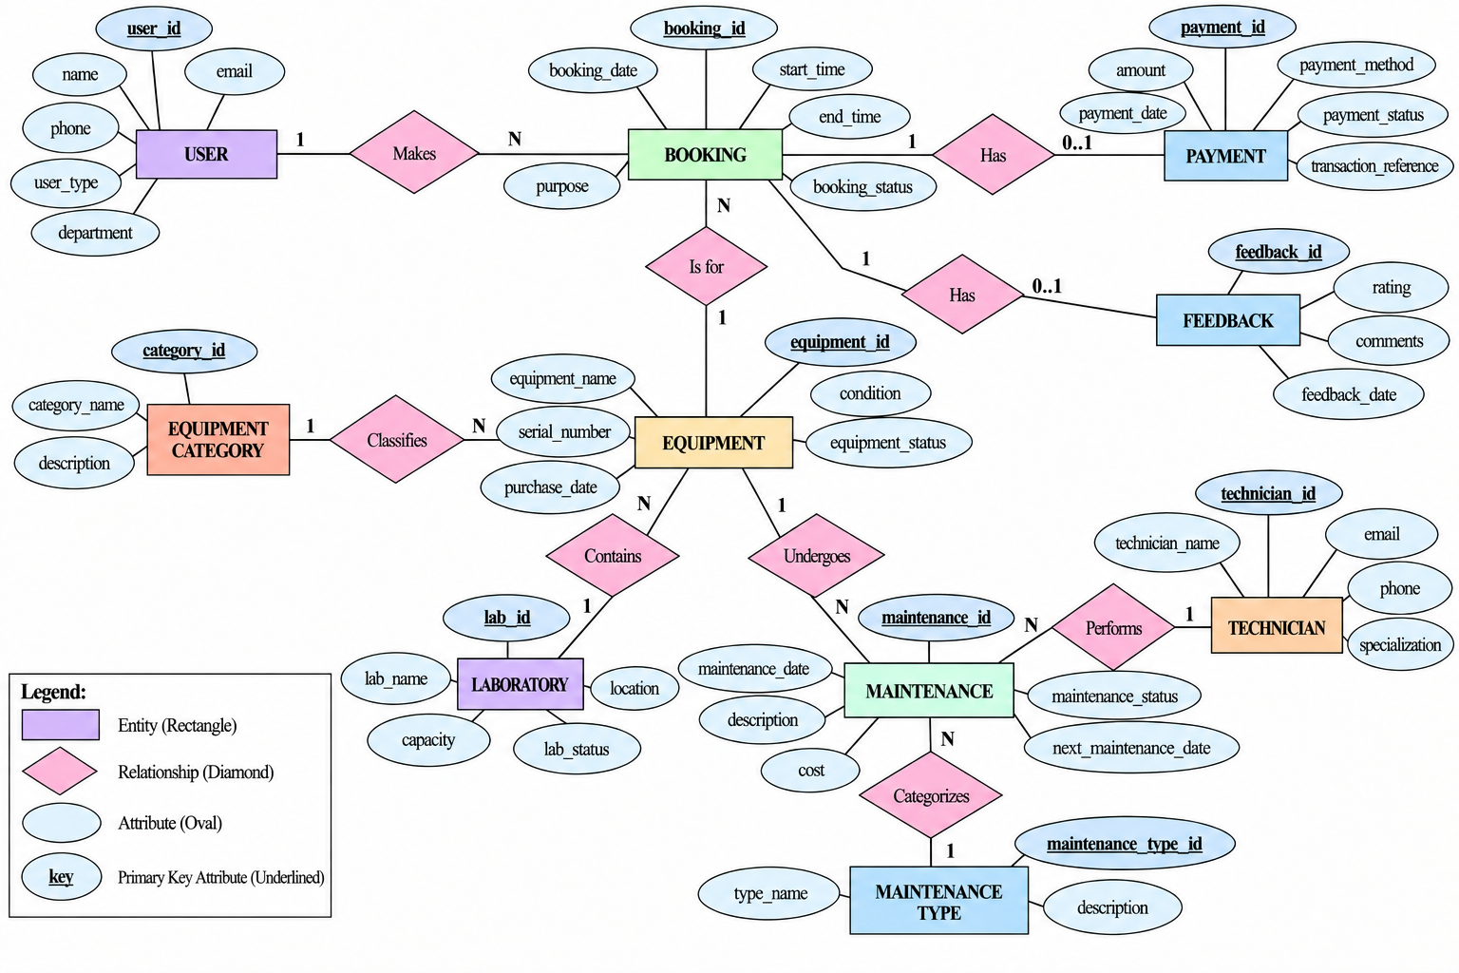
FINAL DATABASE DESIGN
10 tables · 30 records each · referential integrity through foreign keys
10 tables: USER, LABORATORY, EQUIPMENT_CATEGORY, EQUIPMENT, BOOKING, TECHNICIAN, MAINTENANCE_TYPE, MAINTENANCE, FEEDBACK, PAYMENT
Keys: auto-increment primary keys; 13 foreign keys
Rules: NOT NULL, UNIQUE, CHECK, DEFAULT
Data: 30 sample rows in every table
3
Notes:
This is the ER diagram from Presentation II. USER makes BOOKING; BOOKING is for EQUIPMENT; each booking can have one PAYMENT and one FEEDBACK. EQUIPMENT belongs to a LABORATORY and a CATEGORY and undergoes MAINTENANCE, which is performed by a TECHNICIAN and classified by MAINTENANCE_TYPE. These foreign keys are what protect the data - you will see the database refuse a delete that would orphan records.

Slide 4
TECHNOLOGY STACK & ARCHITECTURE
How the UI talks to the database
BROWSER
FLASK (PYTHON)
PyMySQL DRIVER
MySQL
HTML · CSS
Forms, tables,
confirmations
→
Routes · validation
Business rules
Jinja2 templates
→
Parameterised SQL
Commit / rollback
Error handling
→
laboratory_management
10 tables
PK · FK · CHECK
Why a web UI? runs on any laptop, no install for users, easy to demo
Why Flask? small, readable Python; fits a DBMS project
Security: parameterised queries - no SQL injection
Run: pip install flask pymysql → python app.py
Open: http://127.0.0.1:5000
Config: host, user, password in config.py
4
Notes:
Three layers. The browser sends a request; Flask validates it and applies the business rules; PyMySQL runs a parameterised SQL statement on MySQL; the result comes back as a page. Parameterised queries prevent SQL injection. The same SQL that I run in the MySQL console is shown on screen after every operation, so the change in the database is visible.

Slide 5
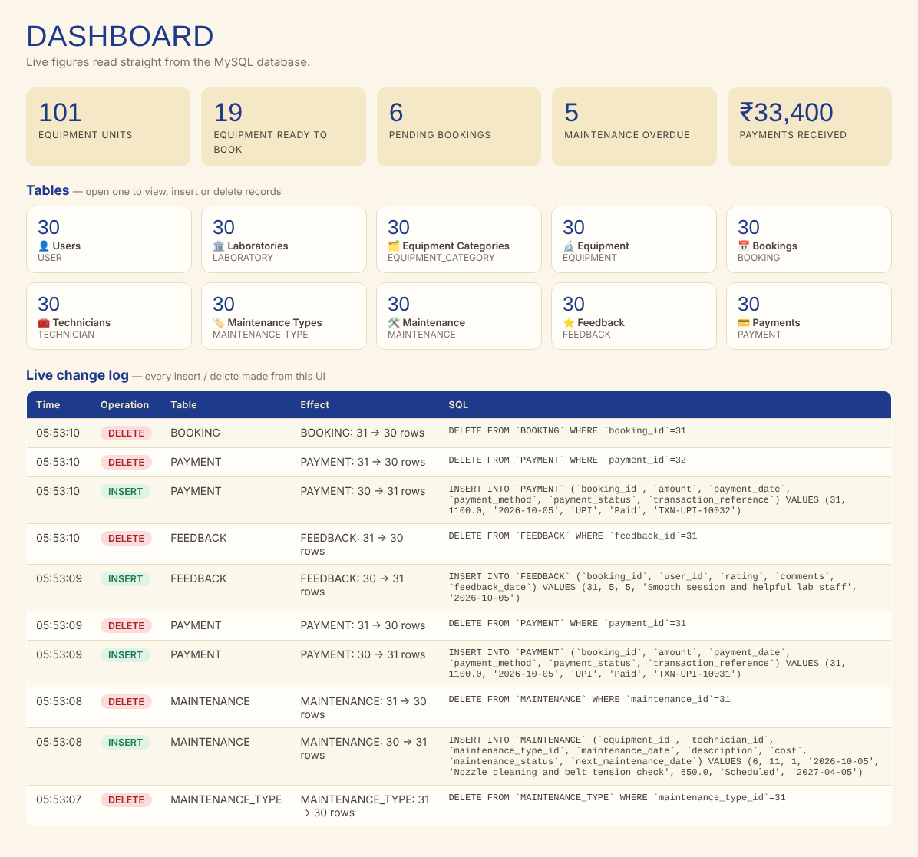
USER INTERFACE OVERVIEW
Sidebar navigation to all 10 tables · dashboard · live change log
Dashboard: KPIs computed with COUNT / SUM queries
Table cards: row count of each table - one click to open
Change log: each INSERT / DELETE with its SQL and the row count before → after
SQL Reports: JOIN, GROUP BY and aggregate queries
Colour badges: status columns are colour coded (green / amber / red)
5
Notes:
This is the home screen. Top row: live numbers calculated by SQL queries - total equipment units, equipment ready to book, pending bookings, overdue maintenance, payments received. Below are the ten tables with their current row counts. The bottom panel is the live change log: every insert and delete I make appears here with the exact SQL.

Slide 6
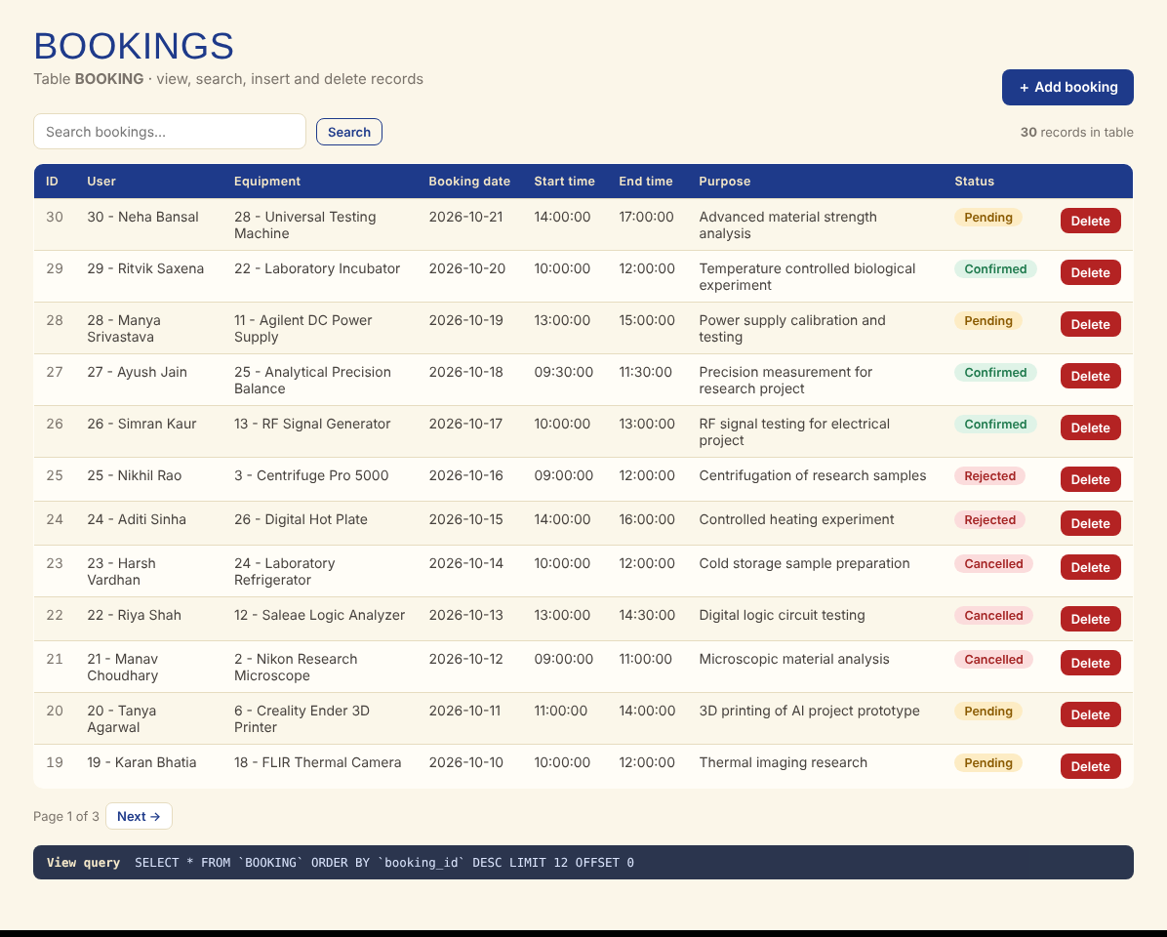
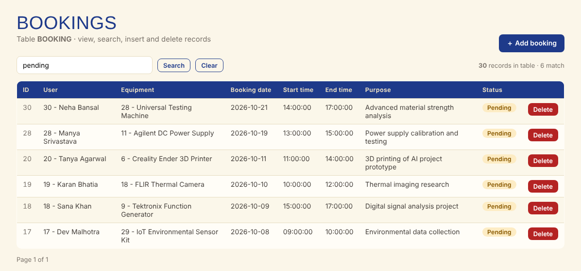
OPERATION 1 · VIEW RECORDS
SELECT with search, pagination and foreign keys shown as names
SELECT reads rows from the table
JOIN-like lookup: IDs displayed as names
Search: LIKE on text columns
Pagination: LIMIT / OFFSET
6
Notes:
VIEW. Opening Bookings runs SELECT * FROM BOOKING ordered newest first, 12 rows per page. Foreign keys are shown as readable names - user 5 is Arjun Kumar, equipment 6 is Creality Ender 3D Printer - by looking up the referenced tables. The query used is displayed at the bottom. The search box filters with LIKE across several columns. DEMO: open Bookings, type 'pending' in search.

Slide 7
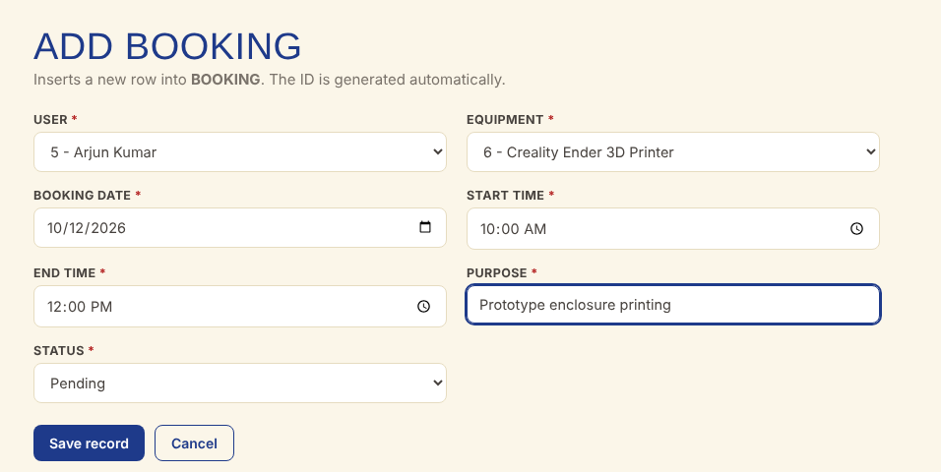
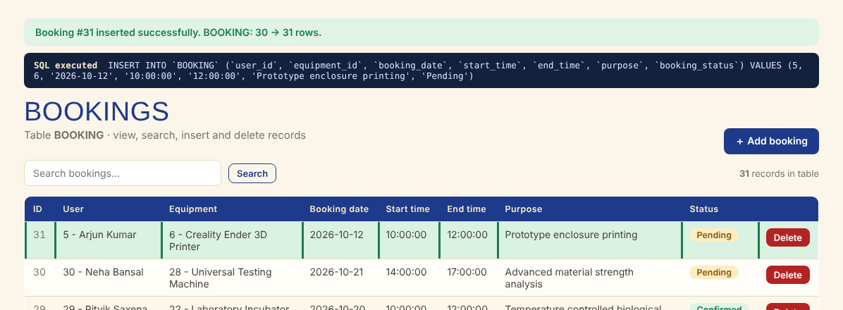
OPERATION 2 · INSERT RECORD
Form with validation → INSERT INTO → row count 30 → 31
STEP 1 · FILL THE FORM
STEP 2 · RESULT: ROW ADDED (BEFORE 30 → AFTER 31)
Drop-downs guarantee valid foreign keys
Date / time pickers prevent format errors
Required fields match NOT NULL columns
SQL shown: INSERT INTO `BOOKING` (...) VALUES (5, 6, '2026-10-12', '10:00:00', '12:00:00', ...)
Proof: banner shows BOOKING: 30 → 31 rows; new row highlighted in green
Same on every table: all 10 tables have an Add form
7
Notes:
INSERT. I click Add booking. Drop-downs are filled from the USER and EQUIPMENT tables so only valid foreign keys can be chosen. I pick user, equipment, date and time and save. The app runs INSERT INTO BOOKING, the green banner confirms it, the SQL is displayed, the row count moves from 30 to 31 and the new row is highlighted at the top. DEMO: do this live, then show the same row in the MySQL console with SELECT * FROM BOOKING ORDER BY booking_id DESC LIMIT 1.

Slide 8
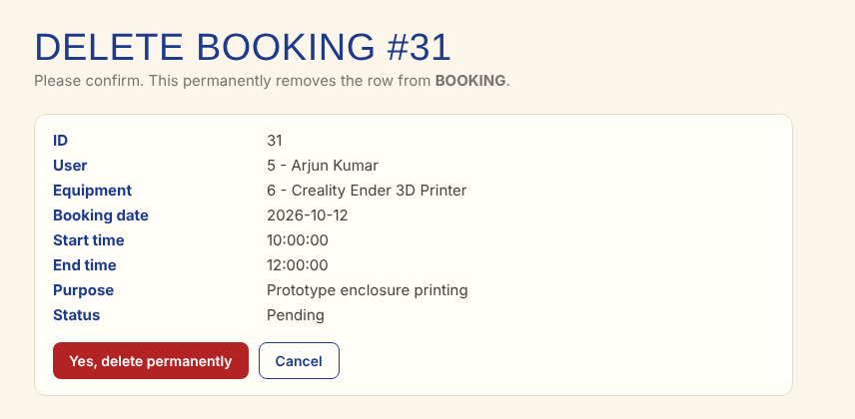
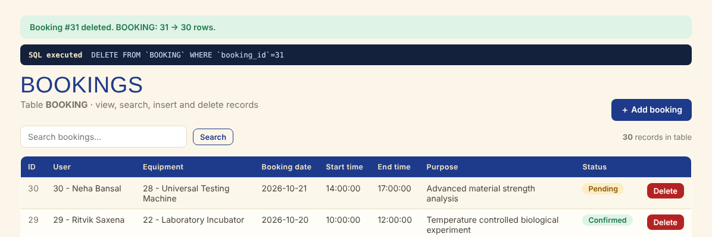
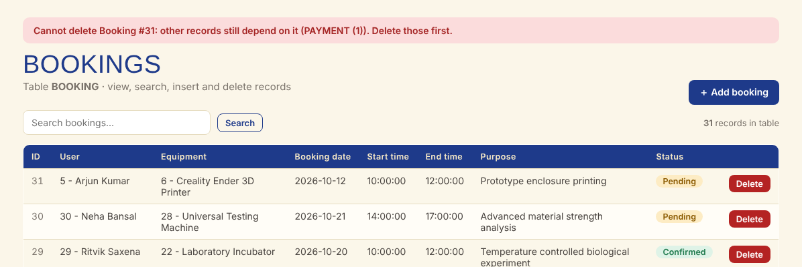
OPERATION 3 · DELETE RECORD
Confirmation page → DELETE FROM → row count 31 → 30
STEP 1 · CONFIRM
STEP 2 · ROW REMOVED (31 → 30)
PROTECTED BY FOREIGN KEY
Safe delete: a confirmation page shows the full record before anything is removed.
SQL: DELETE FROM `BOOKING` WHERE `booking_id`=31 - logged in the change log with rows 31 → 30.
Integrity: a booking that still has a PAYMENT or FEEDBACK cannot be deleted - the foreign key (ON DELETE RESTRICT) stops it and the UI shows which tables depend on it.
Order to remove: child rows (payment, feedback) first, then the booking.
8
Notes:
DELETE. I click Delete on the new booking. A confirmation page shows exactly which record will be removed - no accidental deletes. On confirming, the app runs DELETE FROM BOOKING WHERE booking_id = 31 and the count returns to 30. Important for DBMS: if I try to delete a booking that still has a payment, MySQL's foreign key refuses it, and the app explains why. DEMO: delete the booking I just added; then try to delete booking 1 to show the FK protection.

Slide 9
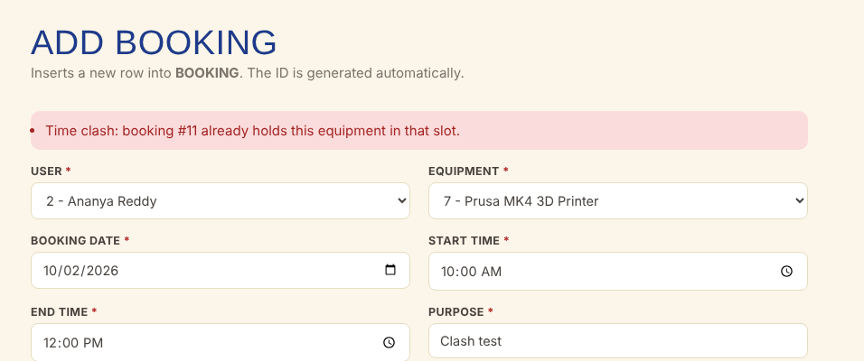
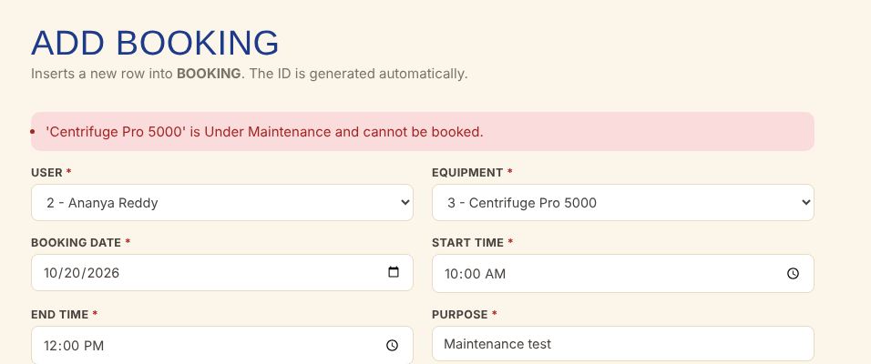
BUSINESS RULES & VALIDATION
The rules from Presentation I are enforced when data is inserted
RULE 1 · NO OVERLAPPING APPROVED BOOKINGS
RULE 2 · EQUIPMENT UNDER MAINTENANCE CANNOT BE BOOKED
Also checked: end time later than start time · valid email and 10-digit phone · amount > 0 · next maintenance date after maintenance date
Database level: UNIQUE (email, serial number), CHECK, NOT NULL and foreign keys reject bad data even if the UI is bypassed
9
Notes:
These are the business rules promised in Presentation I. Left: I try to confirm a booking for the 3D printer Prusa MK4 on 2 October 10 to 12; booking 11 already holds 9 to 11, so the system rejects it - no double booking. Right: I try to book the centrifuge, which is Under Maintenance - rejected. Other checks: end time after start time, valid email, 10-digit phone, positive amount, next maintenance date after maintenance date, unique email and serial number from the database itself.

Slide 10
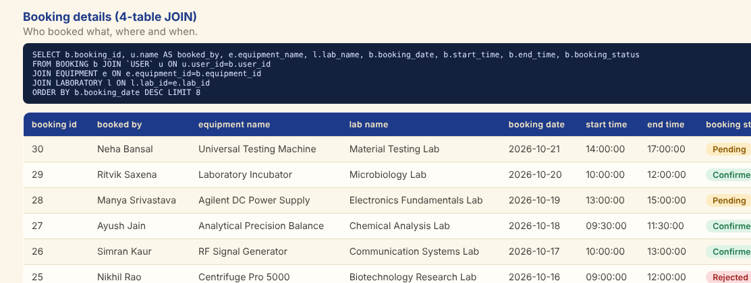
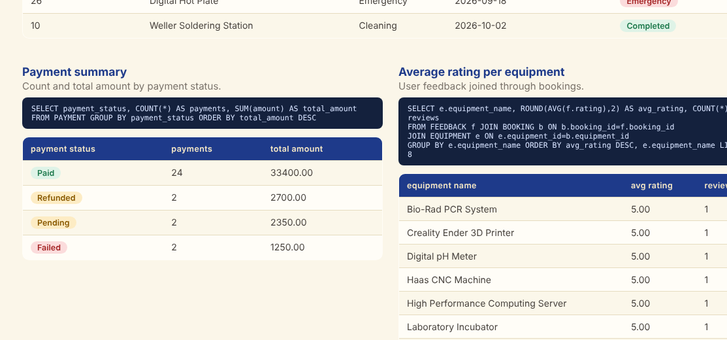
SQL REPORTS
JOIN · GROUP BY · aggregate functions on the live database
Booking details: 4-table JOIN (BOOKING, USER, EQUIPMENT, LABORATORY)
Utilisation: COUNT + GROUP BY per equipment
Maintenance overdue: next_maintenance_date earlier than today
Needs attention: equipment Under Maintenance or Damaged
Payments: SUM and COUNT by status
Ratings: AVG(rating) per equipment, joined through bookings
10
Notes:
Six analysis queries run live from the Reports page: a 4-table JOIN for booking details, bookings per equipment with GROUP BY, overdue maintenance using a date comparison, equipment needing attention, payment totals by status using SUM, and average rating per equipment using AVG. The SQL of every report is displayed above its result.

Slide 11
TESTING
Test cases run against the UI and the database
# | Test case | Expected result | Result
1 | Open each of the 10 tables | Rows displayed with names for FKs | Pass
2 | Insert valid booking | Row added, count 30 → 31 | Pass
3 | Insert booking that overlaps a confirmed slot | Rejected - time clash message | Pass
4 | Insert booking for equipment under maintenance | Rejected - cannot be booked | Pass
5 | End time earlier than start time | Rejected | Pass
6 | Invalid e-mail / phone number | Rejected by form validation | Pass
7 | Insert user with duplicate e-mail | Rejected by UNIQUE constraint | Pass
8 | Payment amount = 0 / next date before maintenance date | Rejected | Pass
9 | Delete a record with no dependants | Row removed, count 31 → 30 | Pass
10 | Delete a record that has dependants | Refused by foreign key; reason shown | Pass
11
Notes:
I tested valid and invalid cases for each operation. All of these behaved as expected. Highlight the integrity tests: duplicate email rejected by UNIQUE, delete of a referenced record rejected by the foreign key.

Slide 12
CONCLUSION & FUTURE ENHANCEMENTS
Delivered
• Normalised MySQL database - 10 tables, PK / FK / CHECK / UNIQUE
• Web UI: view, search, insert, delete on every table
• Business rules: no double-booking, equipment status, valid dates
• Dashboard, live change log and 6 SQL reports
• Tested with valid and invalid inputs
Future enhancements
• Login with roles (student, faculty, technician, admin)
• Edit / update records and booking approval workflow
• Automatic e-mail reminders for calibration and maintenance due dates
• Online payment gateway integration
• QR-code check-in / check-out of equipment
• Usage analytics charts and mobile app
12
Notes:
To conclude: the project delivers a normalised 10-table MySQL database and a working interface for insert, delete and view with business rules enforced. Future work: login with roles, online payment gateway, email reminders for calibration, QR-code check-in of equipment, and a mobile app. Thank you - I am happy to take questions.

Slide 13
THANK YOU!
Notes:
Thank you. Questions welcome.

